Slide 1
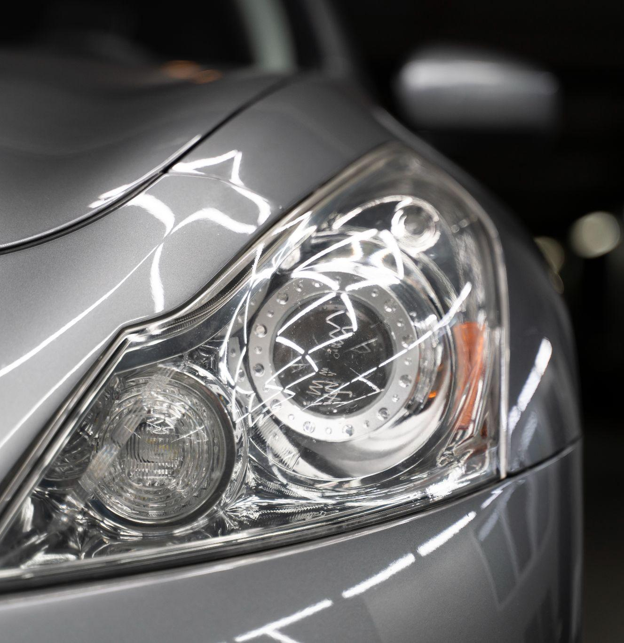
Car price prediction model auto consulting firm
“
“
Notes:
דגם חיזוי מחיר רכב

Slide 2

ABOUT THE PROJECT
“
“

Slide 3

Problem Statement
The car company hired a consulting firm to analyze car pricing factors in the US market, identify significant variables for price prediction, and assess their accuracy. The consulting firm collected data on various car types in the US market through market surveys.

Slide 4


OUR GOALS
Analysis
Modeling
Understanding pricing dynamics in a new market
Car price prediction model for business strategy

Slide 5
Attribute Information
There are 25 features, This is a glimpse of some features:
Car_ID | Unique id of each observation (Integer),
Symboling | Its assigned insurance risk rating, A value of +3 indicates that the auto is risky, -3 that it is probably pretty safe (Categorical).
carCompany | Name of a car company (Categorical)
fueltype | Car fuel type i.e gas or diesel (Categorical).
horsepower | Horsepower (Numeric)
price | Price of the car (Numeric)(Dependent variable).

Slide 6
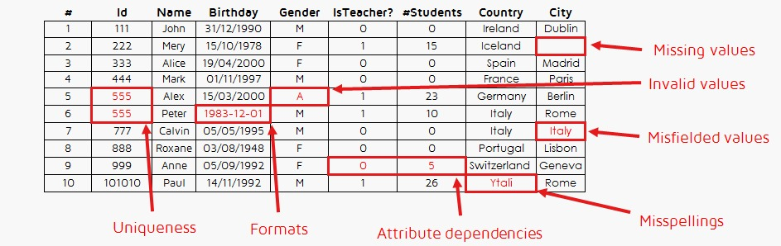
Cleaning Data

Slide 7
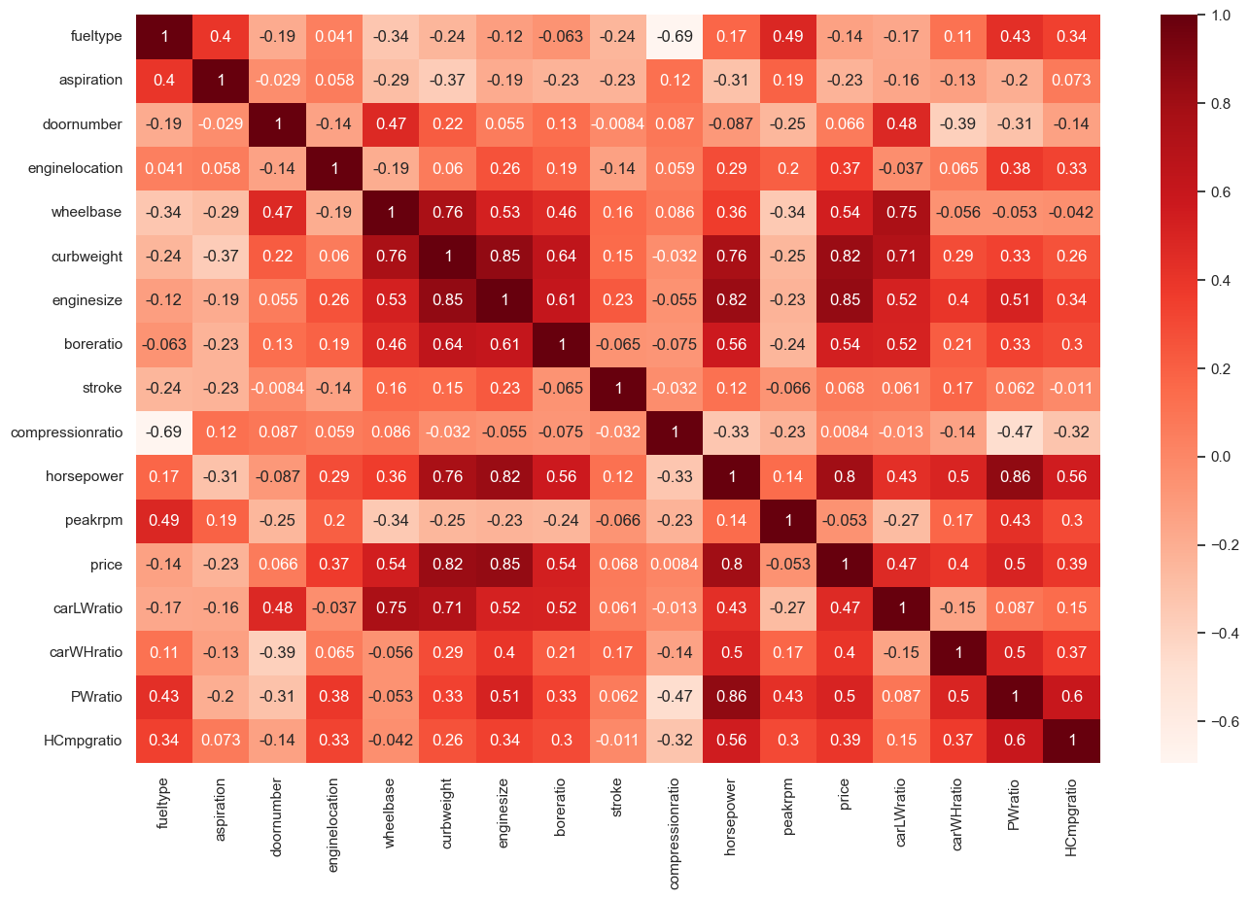
Data Analysis
Data analysis reveals features positively correlated with car prices, including:
wheelbase
carlength
carwidth
curbweight
enginesize
boreratio
horsepower
Some variables negatively associated with the price variable include:
citympg
highwaympg

Slide 8
Data Analysis
After further analysis of these variable relationships.
We have combined some features that have correlations and insert new features:
carLWratio = carlength/carwidth.
carWHratio = carwidth/carheight.
PWratio = horsepower/curbweight.
HCmpgratio = highwaympg/citympg.
So, we removed features with interdependent relationships, including carlength, carwidth, carheight, highwaympg, and citympg.

Slide 9
Models
“
“

Slide 10
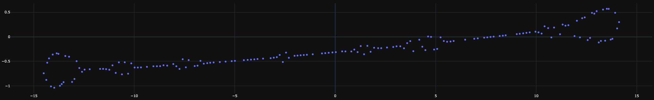
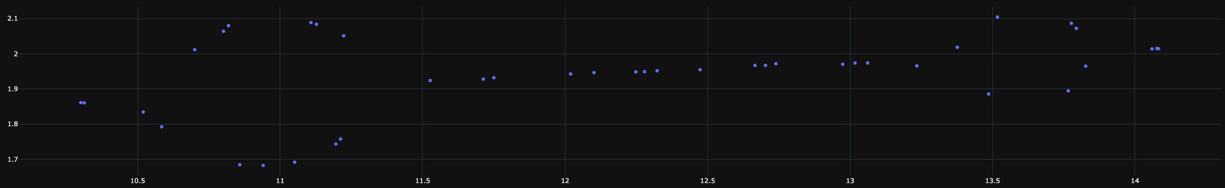
Data Display Using t-sne
Train Set (%80)
Test Set (%20)

Slide 11
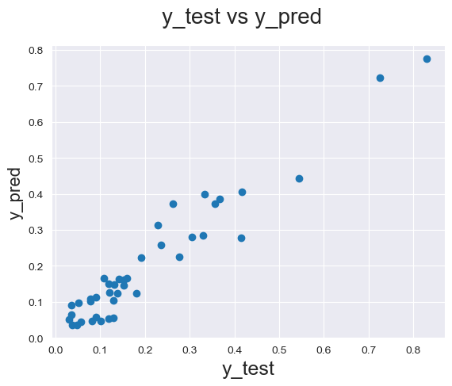
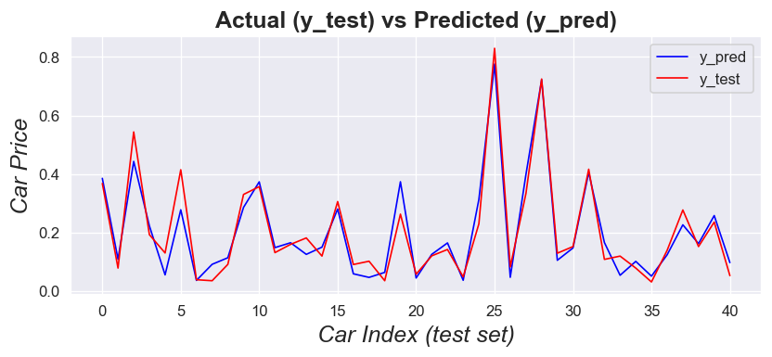
Linear Regression Model
Measure Name | Value
MAE | 0.0374
MSE | 0.0023
RMSE | 0.0483
Huber Loss | 0.0011
R2 Score | 0.9264

Slide 12
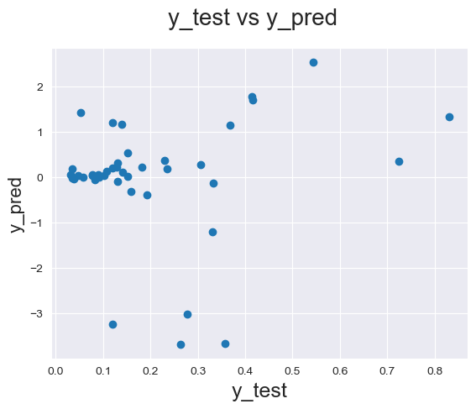
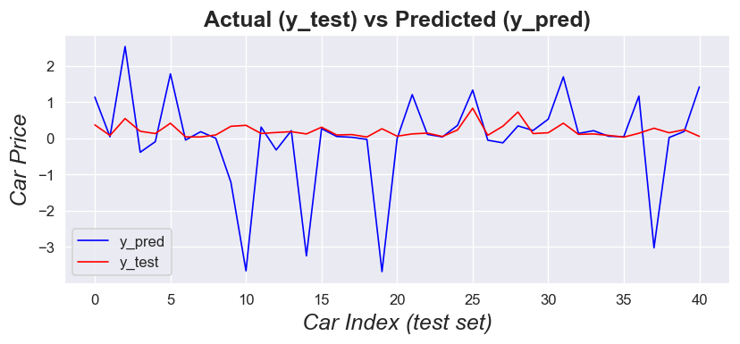
Polynomial Regression Model (degree=2)
Measure Name | Vlaue
MAE | 0.7230
MSE | 1.7086
RMSE | 1.3071
Huber Loss | 0.2876
R2 Score | -52.8445

Slide 13
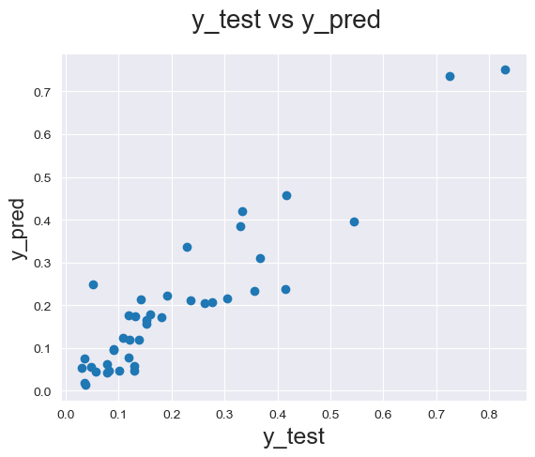
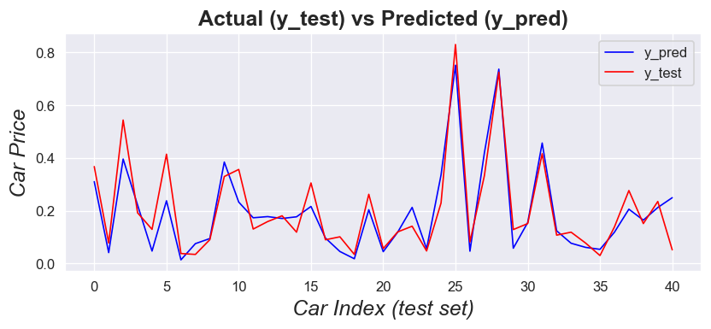
Neural Network Regression Mode
Measure Name | Vlaue
MAE | 0.0507
MSE | 0.0046
RMSE | 0.0684
Huber Loss | 0.0023
R2 Score | 0.8522
MLPRegressor(hidden_layer_sizes=(100, 250, 100, 50), alpha=0.05, activation='relu', solver='adam)

Slide 14
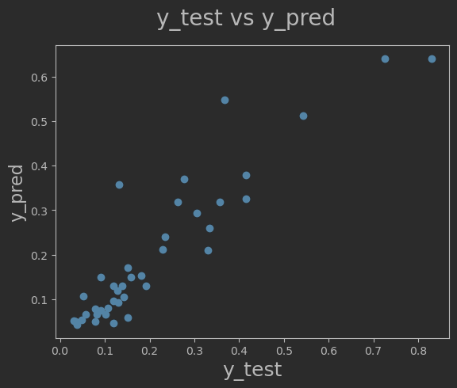
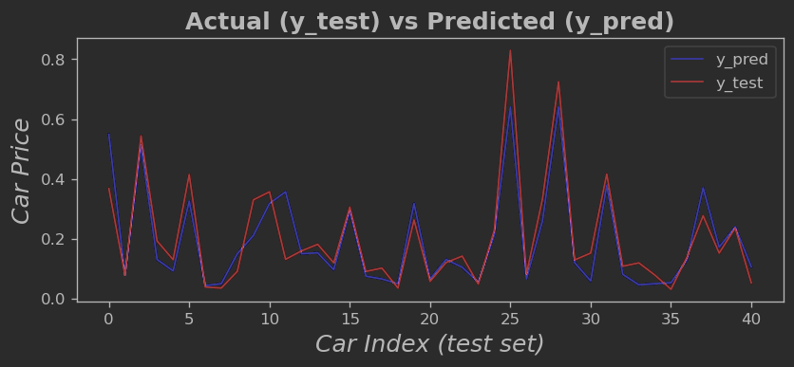
Decision Tree Regression Model
Measure Name | Vlaue
MAE | 0.0480
MSE | 0.0049
RMSE | 0.0705
Huber Loss | 0.0024
R2 Score | 0.8432

Slide 15
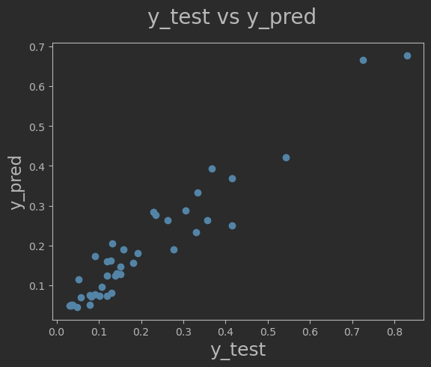
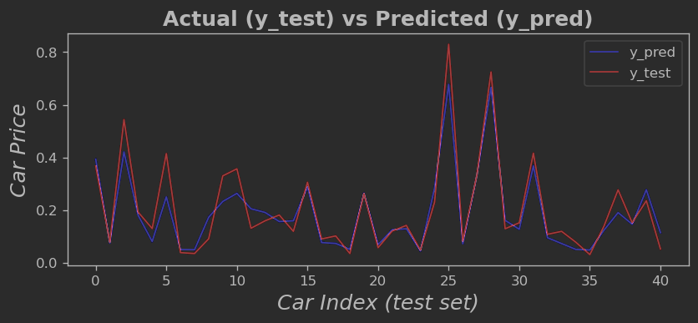
Random Forest Model (estimators=700)
Measure Name | Vlaue
MAE | 0.0402
MSE | 0.0032
RMSE | 0.0566
Huber Loss | 0.0016
R2 Score | 0.8989

Slide 16
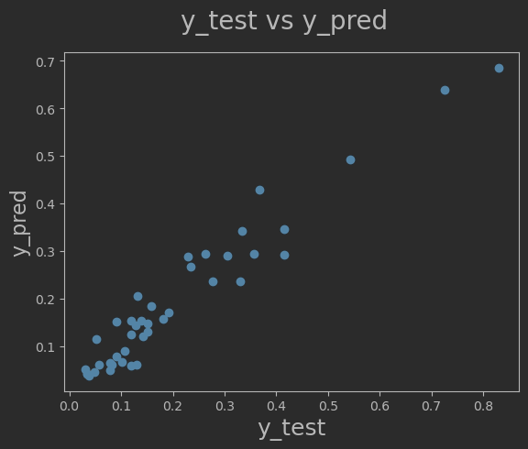
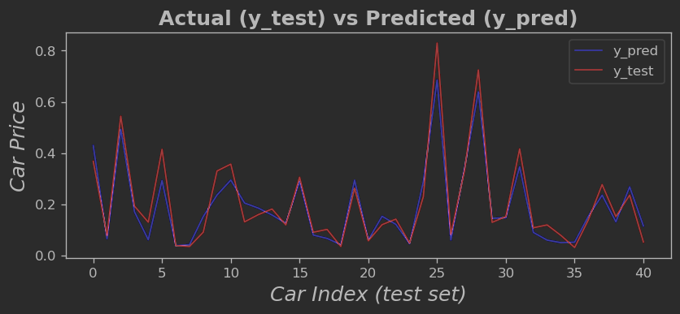
XGBoost Regressor Model
Measure Name | Vlaue
MAE | 0.0380
MSE | 0.0025
RMSE | 0.0503
Huber Loss | 0.0012
R2 Score | 0.9200

Slide 17
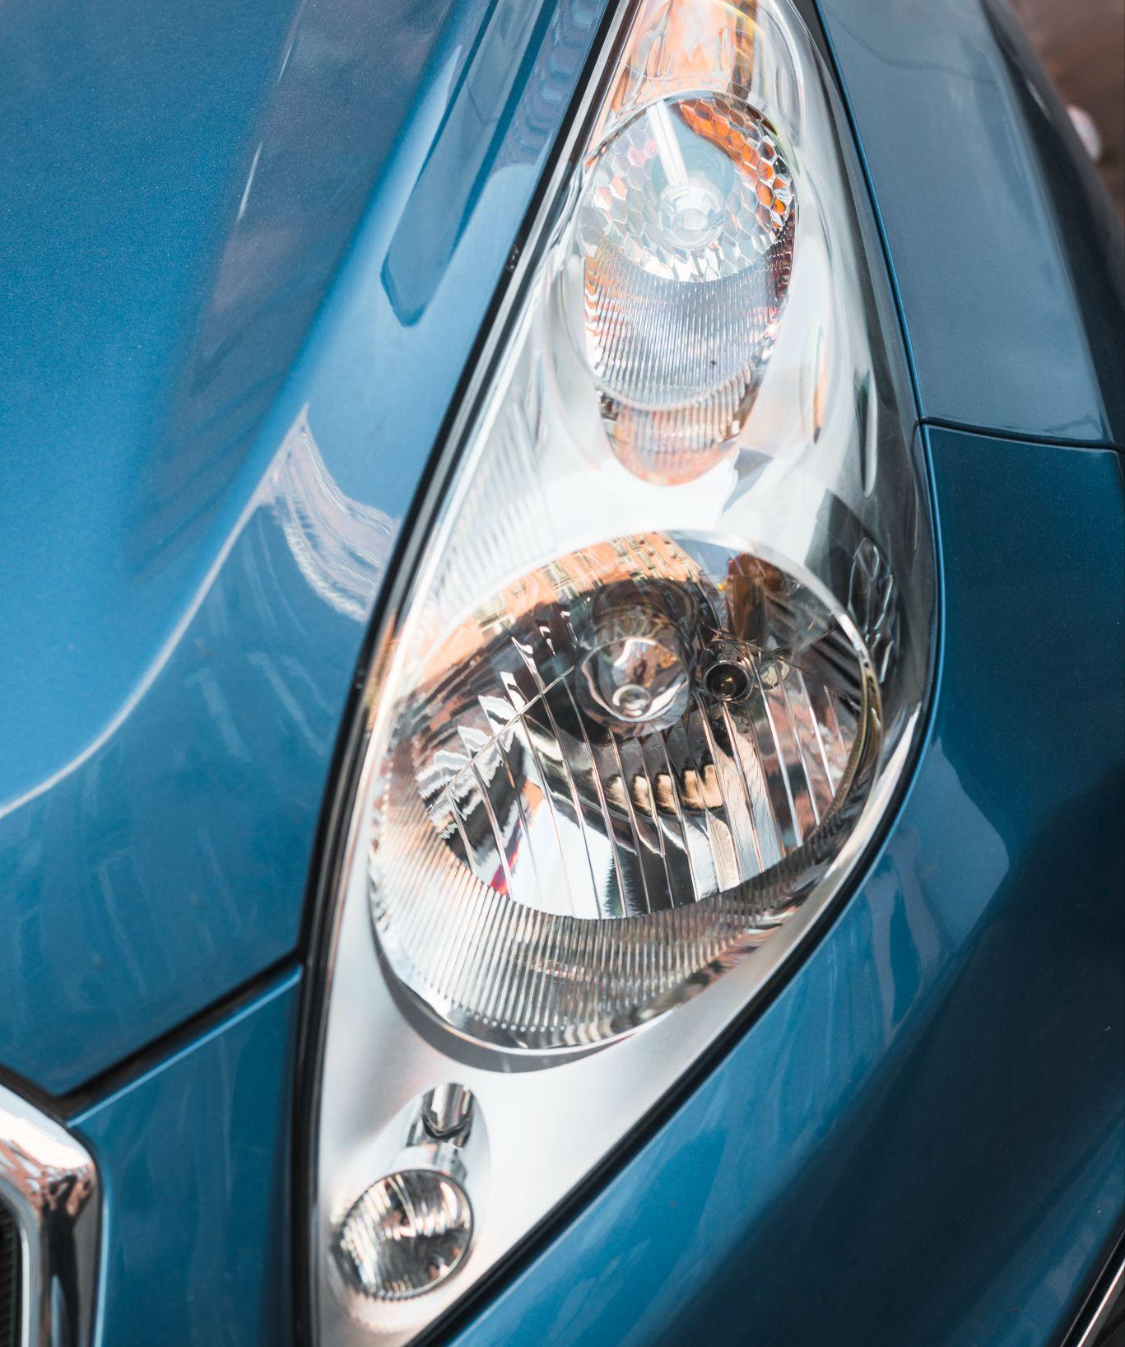
THANKS!
Do you have any questions?
“

